Slide 1















DYNAMIC ROUTE OPTIMIZATION AND EMISSION REDUCTION SYSTEM

Slide 2
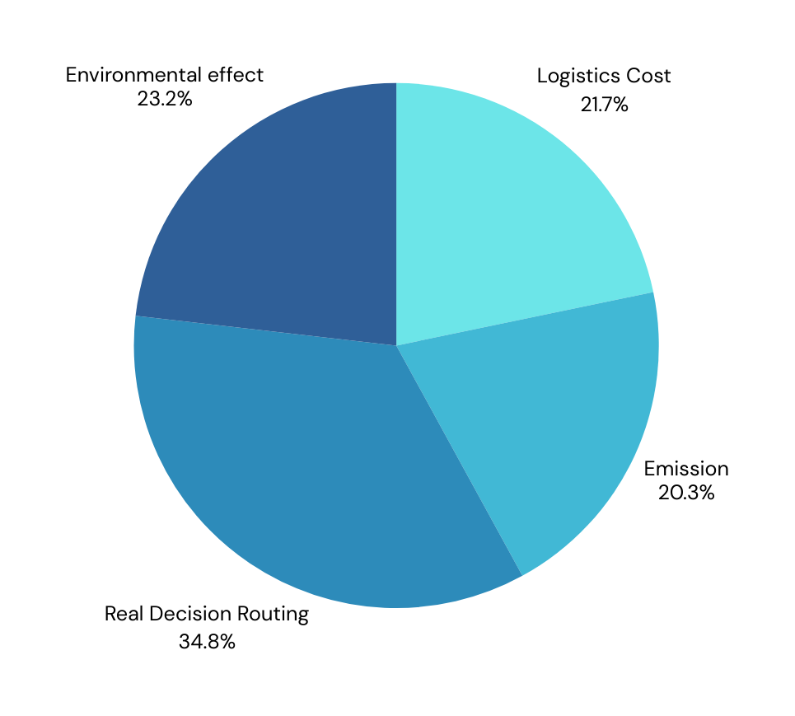
STATEMENT OVERVIEW
Develop a Python-based dynamic routing system using real-time data from various
applicable APIs.
Optimize vehicle routes considering traffic, weather, and vehicle-specific details.
Estimate and minimize vehicle emissions for each route.
Ensure the system is user-friendly and accessible.

Slide 3
Project Workflow
Map view of destination via use of google maps
Input of data[origin , destination , vehicle type
Get exact information of postponed weather and air current
Website
Get Duration , distance, optimized route ,carbon footprints for the trip
Uses Tom Tom Api ,OSRM Api routing and google maps api for route optimization and AQICN for Air quality and weather

Slide 4





System Architecture
Core Components:
Python backend with flask framework
RESTful API integration layer
Real-time data processing engine
Route optimization algorithm
API Integration:
TomTom: Traffic data
AQICN: Air quality and weather
OSRM: Route generation
Google Maps: Geocoding and visualization via rapid api

Slide 5
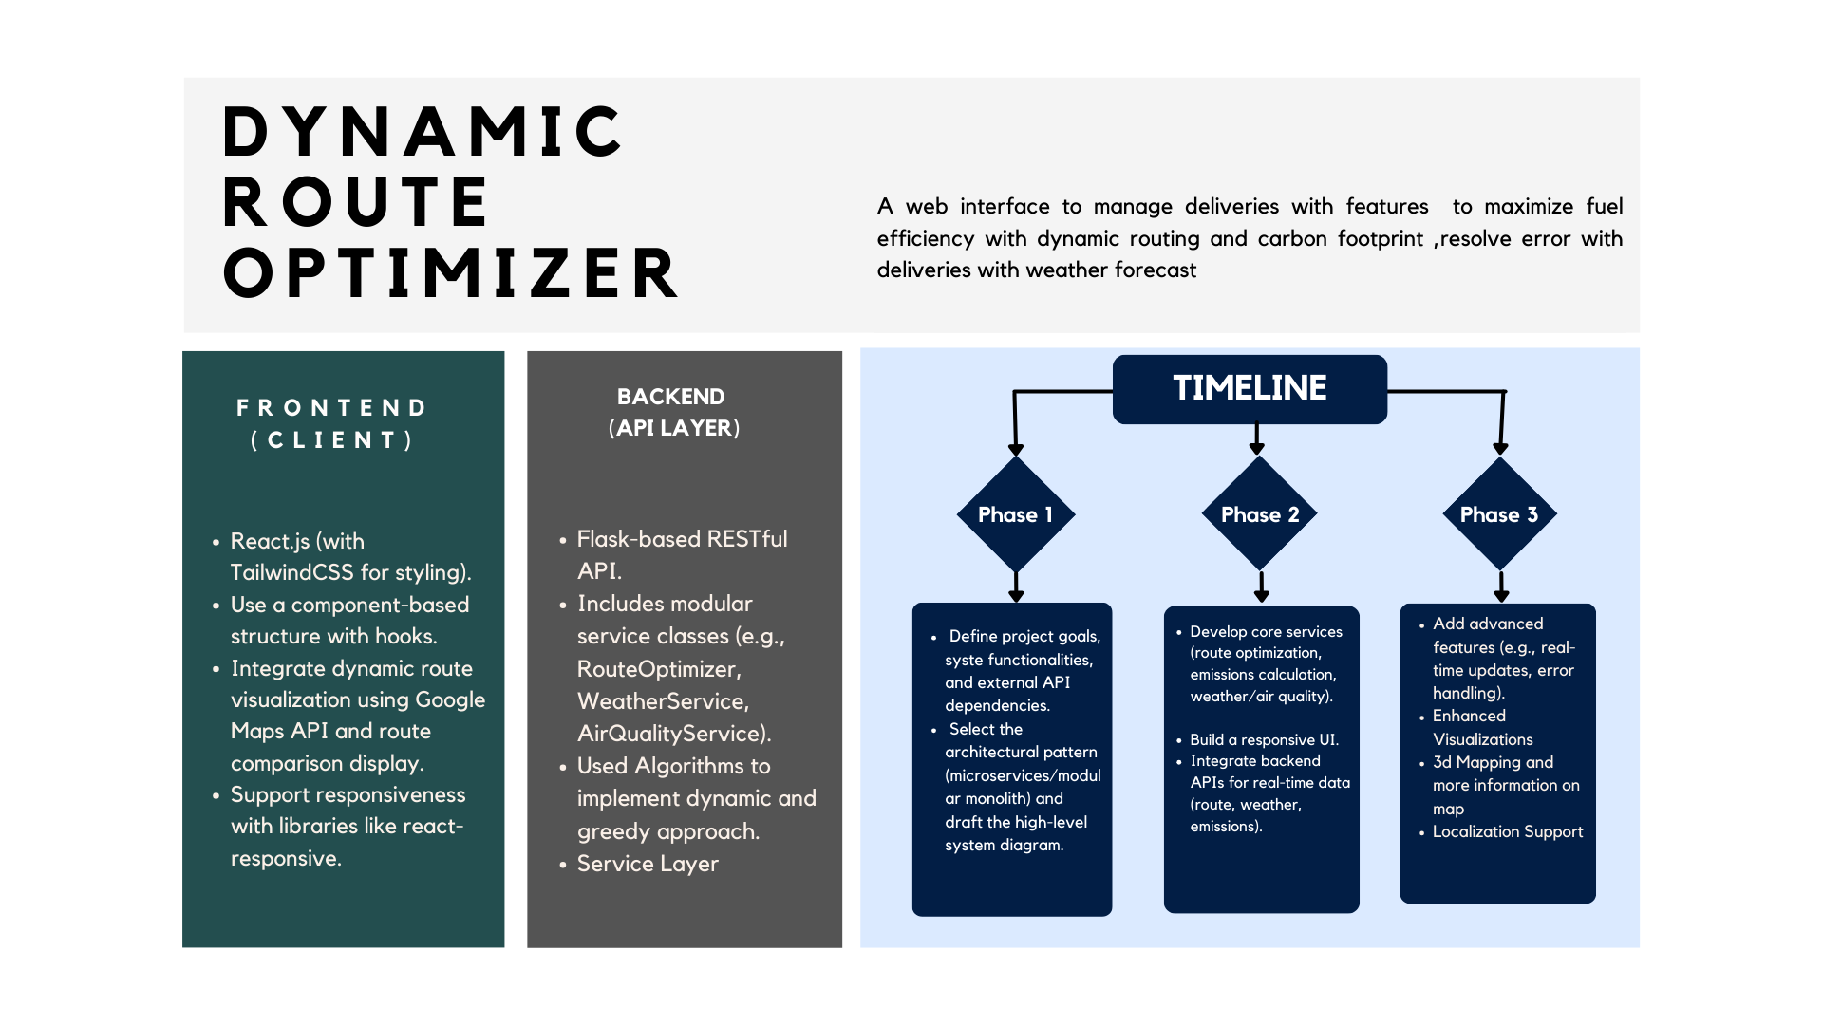

Slide 6
Key Features
01
02
03
Route Optimization:
Multiple route options
Dynamic rerouting
Time window constraints
Carbon footprints for better environment
Real-time Traffic Monitoring like Live traffic updates every 2 minutes and Congestion prediction and Incident alerts with 2d mapping
Weather Integration:
Current conditions
Weather forecasts
Impact assessment

Slide 7

Data Sources
Traffic Data:
Real-time traffic flow
Historical patterns
Road closures
Weather Information:
Temperature
Precipitation
Wind conditions
Vehicle Data:
Fuel efficiency
Emissions ratings
Capacity utilization

Slide 8

15% fuel cost reduction
20% lower CO2 emissions
could lead to significant savings for both consumers and businesses. For households, this reduction means more disposable
20% improved delivery times
.
Reduced carbon footprint by 30%
BENEFITS
25% reduced idle time
Better air quality compliance by 10%

Slide 9
Thank you very much!

